Slide 1
Obama’s BRAIN:
a view of science policy from inside the White House
Philip Rubin, Ph.D.
Senior Advisor to the President and CEO Emeritus, Haskins Laboratories
Professor Adjunct, Department of Surgery, Yale School of Medicine
(Formerly: Principal Assistant Director for Science of the
White House Office of Science and Technology Policy )

Slide 2
Excerpts from: Committee Report, 112th Congress (2011-2012), House Report 112-284
“TITLE III – SCIENCE
OFFICE OF SCIENCE AND TECHNOLOGY POLICY
Neuroscience. – The conferees believe there is a potential in the near future for significant, transformative advances in our fundamental understanding of learning, brain development, and brain health and recovery. Such advances will require enhanced tools to better understand the working of the brain, enhanced data and data infrastructure, and expanded interdisciplinary and large-scale research efforts.

Slide 3
The White House
Neuroscience
Initiative

Slide 4
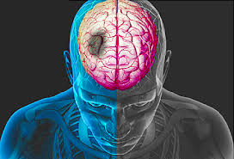
Why is the administration interested?
Neurological disorders affect more than 50 million Americans every year, and cost more than $760 billion to treat.
It has been projected that delaying the onset of Alzheimer’s disease by just five years could save $50 billion in annual U.S. health care costs (Alzheimer’s Association, 2010).
Nearly 800,000 Americans suffer a stroke each year, costing the United States an estimated $54 billion per year due to the expenses of health care services, medications, and missed days of work.
Traumatic Brain Injury (TBI) impacts approximately 2.5 million Americans each year. Severe TBI can negatively affect cognitive and motor function, sensation, and emotions, extracting a harsh human cost. (CDC National Center for Injury Prevention)
The economic and human costs and challenges are profound

Slide 5
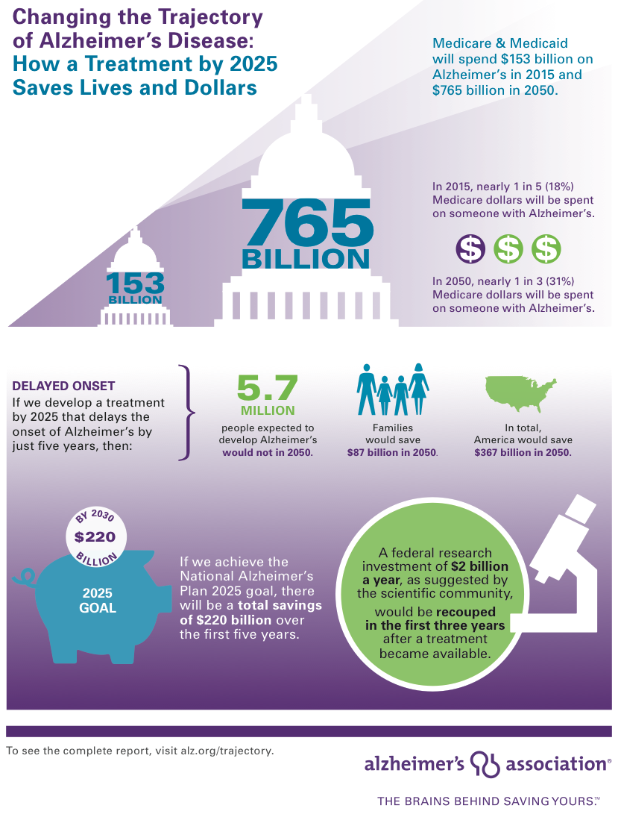

Slide 6
What are the White House Neuroscience Initiative’s goals ?
Develop a strategy towards significant, transformative discoveries in fundamental and translational Neuroscience and Cognitive Science through coordinated Federal efforts and synergy with outside stakeholders.
Office of Science and Technology Policy (OSTP):
Incorporate and heighten the President’s emphasis on neuroscience through Administration-wide initiatives and activities.

Slide 7
The place of science in the White House…
…is centered in the Office of Science and Technology Policy (OSTP)
Office of Management & Budget (OMB)
National Security Council (NSC)
President
Council on Environmental Quality (CEQ)
National Economic Council (NEC)
OSTP
Council of
Economic
Advisors (CEA)
Domestic Policy Council (DPC)
The Executive Office of the President (EOP) also includes Offices of: Vice President, Chief of Staff, Cabinet Affairs, Communications, General Counsel, Intergovernmental Relations, Public Engagement, Social Secretary, US Trade Representative, Energy & Climate Change, and more.

Slide 8
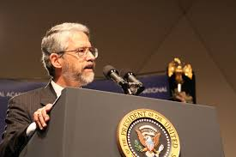
The mission of the White House Office of Science and Technology Policy (OSTP), led by the President’s Science Advisor, Dr. John P. Holdren, is threefold:
• first, to provide the President and his senior staff with accurate, relevant, and timely scientific and technical advice on all matters of consequence;
• second, to ensure that the policies of the Executive Branch are informed by sound science;
• third, to ensure that the scientific and technical work of the Executive Branch is properly coordinated so as to provide the greatest benefit to society.

Slide 9
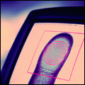
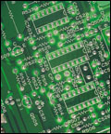
PRESIDENT
OFFICE OF THE CHIEF TECHNOLOGY OFFICER
PRESIDENT’S COUNCIL OF ADVISORS ON SCIENCE & TECHNOLOGY (PCAST)
OSTP Director
NATIONAL SCIENCE AND TECHNOLOGY COUNCIL (NSTC)
ENVIRONMENT & ENERGY
NATIONAL SECURITY & INTERNATIONAL AFFAIRS
TECHNOLOGY & INNOVATION
SCIENCE

Slide 10
Science Division: Key Priorities, 2012 - 2015
Innovation, Inclusion, Infrastructure, and Inspiration
• Support for fundamental and translational research
• Public Access to research results; Open Data and Open Science
• Biomedical innovation, including antibiotic resistance and precision medicine
• Neuroscience, mental health, cognitive science, learning, behavioral impacts
• Broadening participation in science and STEM education
• Forensic science: National Commission on Forensic Science (DOJ; NIST)
• Language and communication
• Regulatory: Uniform Guidance for research; human subjects issues

Slide 11
National Science and Technology Council
(NSTC)
Committee on Environment, Natural Resources, and Sustainability (CENRS)
Committee on Homeland & National Security (CHNS)
Committee on Science (CoS)
Committee on STEM Education (CoSTEM)
Committee on Technology (CoT)

Slide 12
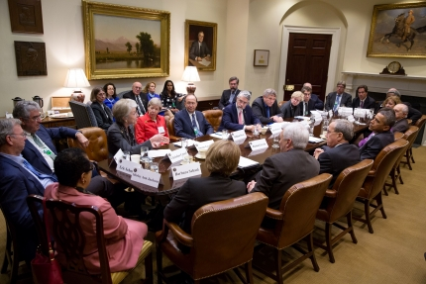
The President’s Council of Advisors
on Science and Technology
(PCAST)
PCAST is an advisory group of the nation’s leading scientists and engineers who directly advise the President and the Executive Office of the President. PCAST makes policy recommendations in the many areas where understanding of science, technology, and innovation is key to strengthening our economy and forming policy that works for the American people.
John P. Holdren (co-chair)
Eric Lander (co-chair)
William Press (vice-chair)
Maxine Savitz (vice-chair)

Slide 13
The White House Neuroscience Initiative
National Alzheimer’s Action Plan
Interagency Working Group on Neuroscience
Executive Order on Improving Access to Mental Health Services for Veterans, Service Members, and Military Families – National Research Action Plan
BRAIN (Brain Research through Advancing Innovative Neurotechnologies) Initiative
Improving Mental Health Prevention and Treatment Services
Ethical, Legal, and Societal Impacts

Slide 14
The White House Neuroscience Initiative
National Alzheimer’s Action Plan
Interagency Working Group on Neuroscience
Executive Order on Improving Access to Mental Health Services for Veterans, Service Members, and Military Families – National Research Action Plan
BRAIN (Brain Research through Advancing Innovative Neurotechnologies) Initiative
Improving Mental Health Prevention and Treatment Services
Ethical, Legal, and Societal Impacts

Slide 15
Interagency Working Group on Neuroscience Agency Representation
Department of Health and Human Services (Co-chair)
National Science Foundation (Co-chair)
Department of Agriculture
Department of Defense
Department of Education
Department of Energy
Department of Homeland Security
Department of Justice
Department of Veterans Affairs
Central Intelligence Agency
Environmental Protection Agency
National Aeronautics and Space Administration
Office of the Director of National Intelligence

Slide 16
Interagency Working Group on Neuroscience Representation of the Executive Office of the President
Office of Science and Technology Policy
Office of Management and Budget,
Office of National Drug Control Policy
Other Executive organizations,
departments, and agencies as the Co-chairs may, from time to time, designate

Slide 17
Interagency Working Group on Neuroscience Mission
Coordinate activities in neuroscience research across the Federal government with a focus on the fundamental understanding of learning, brain development, and plasticity, and applications to brain health and recovery.
Enhance Federal efforts related to:
Improving our understanding of learning and cognition and applying that to improvements in education and other areas
Improving our understanding of a variety of neurological conditions and injuries
Developing appropriate resources, tools, techniques, interventions, and therapies to assist in research, treatment, and recovery

Slide 18
Interagency Working Group on Neuroscience Progress to Date
Identified broad areas of interest for further engagement:
Understanding and treating brain diseases, disorders, and traumas
Understanding and optimizing interactions between the environment and the brain
across the lifespan
Understanding and applying the brain’s information processing capabilities
Enhancing communication among federal agencies and with the public
Identifying concrete examples that Federal agencies can take to create significant
transformative opportunities for improving health, learning, and other outcomes of
national importance

Slide 19
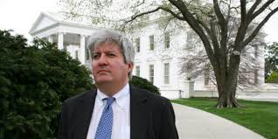
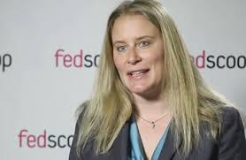
21st Century Grand Challenges
Grand Challenges are ambitious but achievable goals that harness science, technology, and innovation to solve important national or global problems and that have the potential to capture the public’s imagination.
They are an element of the President’s Strategy for American Innovation because they help catalyze breakthroughs that advance national priorities. On April 2, 2013, President Obama called on companies, research universities, foundations, and philanthropists to join him in identifying and pursuing the Grand Challenges of the 21st century.

Slide 20
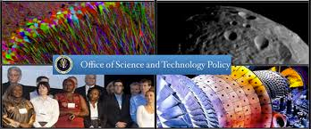
Current Grand Challenges
The BRAIN Initiative
To revolutionize our understanding of the human mind and uncover new ways to treat, prevent, and cure brain disorders. (DARPA, FDA, IARPA, NIH, NSF).
NASA’s Asteroid Grand Challenge
To find all asteroid threats to human populations and know what to do about them
USAID’s Grand Challenges for Development
Including Saving Lives at Birth that catalyzes prevention and treatment for pregnant women and newborns.
DOE’s Sunshot Grand Challenge
To make solar energy cost competitive with coal by the end of the decade, and EV Everywhere Grand Challenge, to make electric vehicles that are as affordable as today's gasoline-powered vehicles within the next 10 years.

Slide 21
A New Grand Challenge
A Nanotechnology-Inspired Grand Challenge for Future Computing
In June 2015, OSTP sought suggestions for
Nanotechnology-Inspired Grand Challenges for the Next Decade.
After considering over 100 responses, OSTP announced on October 20, 2015, the following grand challenge:
Create a new type of computer that can proactively interpret and learn from data, solve unfamiliar problems using what it has learned, and operate with the energy efficiency of the human brain.

Slide 22
The White House Neuroscience Initiative
National Alzheimer’s Action Plan
Interagency Working Group on Neuroscience
Executive Order on Improving Access to Mental Health Services for Veterans, Service Members, and Military Families – National Research Action Plan
BRAIN (Brain Research through Advancing Innovative Neurotechnologies) Initiative
Improving Mental Health Prevention and Treatment Services
Ethical, Legal, and Societal Impacts

Slide 23
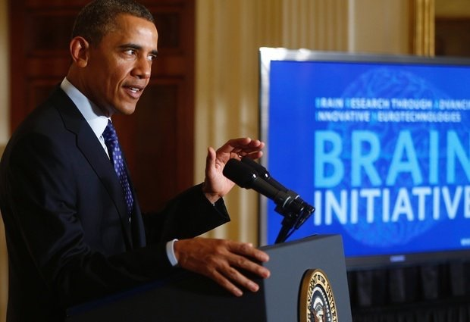
President Obama & the BRAIN
The BRAIN Initiative was launched on April 2, 2013 with approximately $100 million in funding for research supported by the National Institutes of Health (NIH), the Defense Advanced Research Projects Agency (DARPA), and the National Science Foundation (NSF) in the President’s Fiscal Year 2014 budget.

Slide 29
The BRAIN Initiative: Precursors and Catalysts
Decade of the Brain; Decade of Behavior; Decade of the Mind; Science of Mind efforts
NIH: NICHD Literacy Research; NIH Human Brain Project; Neuroscience Blueprint; NIH-NSF Collaborative Research in Computational Neuroscience (CRCNS)
NSF Workshops: Cognitive Neuroscience planning (1999-2000); Convergent Technologies to Improve Human Performance (Dec 3-4, 2001); Integrative Cognitive Science (Oct. 2-3, 2004); Grand Challenges of Mind and Brain (July 2006); Brain Science as a Mutual Opportunity for the Physical and Mathematical Sciences, Computer Science, and Engineering (Aug. 2006); Interdisciplinary Themes (March 2007)
National Academies. NAE - Grand Challenges for Engineering (Feb 15, 2008); IOM Forum on Neuroscience - From Molecules to Minds: Challenges for the 21st Century (June 25, 2008; NRC “Research at the Intersection of Physical and Life Sciences” (2010)
DARPA: Revolutionizing Prosthetics
Allen / Gatsby / Kavli Workshop: Opportunities at the Interface of Neuroscience and Nanoscience (Sep. 2011); Brain Activity Map Project (BAM)
Professional societies: the OSTP “Tractable Problems” exercise (2012)

Slide 30
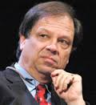
NIH National Institutes of Health
The NIH Blueprint for Neuroscience Research—an initiative that pools resources and expertise from across 15 NIH Institutes and Centers—was a leading NIH contributor to the implementation of this initiative in FY 2014
Advisory Committee to the Director: BRAIN Working Group
Co-Chaired by:
Cornelia Bargmann, Rockefeller University
William Newsome,
Stanford University

Slide 31
Discovering Diversity: identify and access different brain cell types to determine their roles in health and disease
Maps at multiple scales: generate circuit diagrams from synapses to whole brain
The brain in action: produce a dynamic picture of the functioning brain
Demonstrating causality: link brain to behavior using tools that change neural circuit dynamics
Identifying fundamental principles: understanding the biological basis of mental processes through the development of new theoretical and data analysis tools
Advancing human neuroscience: develop technologies to understand the human brain and treat its disorders; support integrated human brain research networks
From BRAIN Initiative to the brain: discover how dynamic patterns of neural activity are transformed into cognition, emotion, perception and action in health and disease
NIH BRAIN 2025 PRIORITIES
TIMELINE
2016–2020:
technology development and validation
2020–2025:
application of those technologies in an integrated fashion
to make fundamental new discoveries about the brain

Slide 32
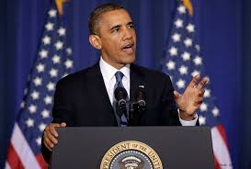
“All Hands on Deck” effort
In April 2014, President Obama called for The BRAIN Initiative to be an “all hands on deck” effort, involving not only the federal government but also companies, health systems, patient advocacy organizations, philanthropists, state governments, research universities, private research institutes, and scientific societies.
There was an enthusiastic response.
“Last year, I launched the BRAIN Initiative to help unlock the mysteries of the brain, to improve our treatment of conditions like Alzheimer’s and autism and to deepen our understanding of how we think, learn and remember. I’m pleased to announce new steps that my Administration is taking to support this critical research, and I’m heartened to see so many private, philanthropic, and academic institutions joining this effort.”
President Barack Obama, Sept. 2014

Slide 33
“All Hands on Deck”
April 2014
NIH
NATIONAL INSTITUTES OF HEALTH
NIH announced $46 million in new BRAIN-related grant awards, focusing on new tools and techniques.
FDA
FOOD AND DRUG ADMINISTRATION
FDA joined The BRAIN Initiative, with the goal of enhancing the transparency of the regulatory landscape for neurological medical devices.
IARPA
INTELLIGENCE ADVANCED
RESEARCH PROJECTS AGENCY
IARPA joined The BRAIN Initiative and is using multidisciplinary approaches to advance understanding of cognition and computation in the brain.
Obama Administration Proposes Over $300 Million in Funding for The BRAIN Initiative
DARPA
DEFENSE ADVANCED
RESEARCH PROJECTS AGENCY
DARPA built on four existing programs to expand their investments in The BRAIN Initiative, with the ultimate goal of assisting and rehabilitating service members and civilians suffering from traumatic injury and neuro-psychiatric illness.
NSF
NATIONAL SCIENCE FOUNDATION
NSF continued to support The BRAIN Initiative by accelerating fundamental research and the development of new technologies for neuroscience and neuroengineering.

Slide 34
“All Hands on Deck”
April 2014
PRIVATE SECTOR COMMITMENTS
US PHOTONICS INDUSTRY $30 MILLION
➔ Develop new optics and photonics technologies
GLAXOSMITHKLINE $5 MILLION
➔ Fund peripheral neurotechnologies and provide unrestricted, royalty-free access for research purposes to all intellectual property developed through this challenge
CONTINUING PROGRESS FROM EXISTING PARTNERS
ALLEN INSTITUTE FOR BRAIN SCIENCE $60 M annually
➔ Understand how brain activity leads to perception, decision making and ultimately action
HOWARD HUGHES MEDICAL INSTITUTE $70 M
➔ Develop new imaging technologies and understand how information is stored and processed in neural networks
KAVLI FOUNDATION $40 M over next 10 years
➔ Provide knowledge for addressing debilitating diseases and conditions
PRIVATE RESEARCH EFFORTS
U. OF PITTSBURGH $65 MILLION
➔ Create a new Brain Institute focused on unlocking the mysteries of normal and abnormal brain function
UC BERKELEY AND CARL ZEISS MICROSCOPY $12 MILLION
➔ Provide infrastructure for neurotechnology development
CARNEGIE MELLON UNIVERSITY $40 MILLION
➔ Commit to supporting the goals of The BRAIN Initiative
THE SIMONS FOUNDATION $62 MILLION
➔ Uncover the patterns of neural activity that produce cognition by combining analyses of internal mental states with studies of sensory and motor processing

Slide 35
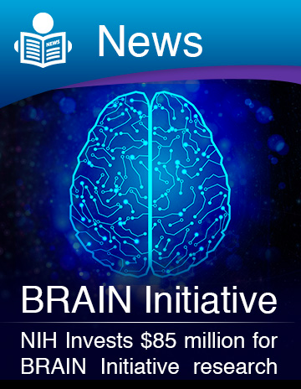
NIH National Institutes of Health
NIH’s contribution to the BRAIN Initiative began with 58 awards made in September 2014, totaling ~$46M, followed by an additional 67 awards totaling ~$39M in FY2015, for a total of ~$85M in new and continuing awards. For FY2016, NIH received additional funds that will bring the total for competing and new awards to $150M, with new awards to be made in late Sep. 2016.
Currently, awards will go to 131 investigators working at 125 institutions in the U.S. and eight other countries. These awards expand NIH’s efforts to develop new tools and technologies to understand neural circuit function and capture a dynamic view of the brain in action. Projects include proposals to develop soft self-driving electrodes, ultrasound methods for measuring brain activity, and the use of deep brain stimulation to treat traumatic brain injuries.

Slide 36
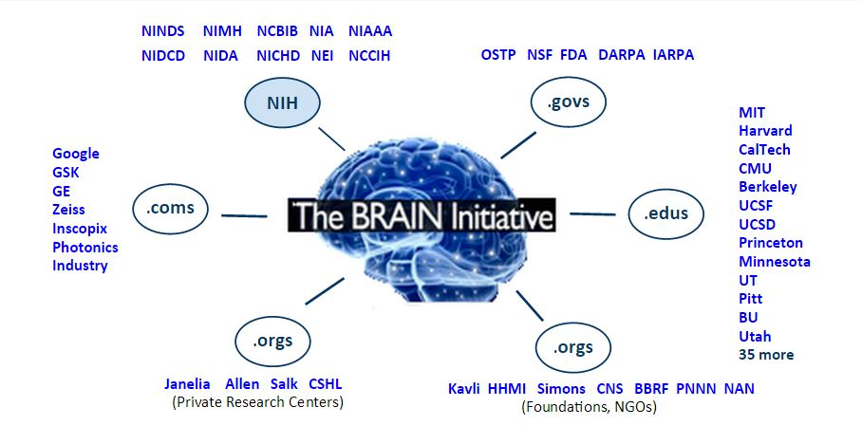
BRAIN Public-Private Partnerships

Slide 37
The National Science Foundation (NSF) supports interdisciplinary research that spans biology, the physical sciences, engineering, computer science, and the social and behavioral sciences.
Despite major technological advances of recent decades, we lack an understanding of how the brain functions in both spatial and temporal domains. The NSF BRAIN Initiative aims to generate an array of physical and conceptual tools needed to determine how healthy brains function over the lifespan of humans and other organisms; and to develop a workforce to create and implement these tools aimed at establishing a more comprehensive understanding of how thoughts, memories and actions emerge from the dynamic activities in the brain. NSF BRAIN Thematic Areas include:
Multi-scale integration of the dynamic activity and structure of the brain
Neurotechnology and research infrastructure

Slide 38
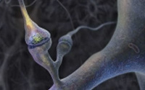
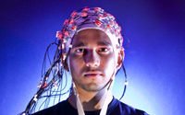
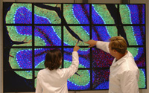
Quantitative theory and modeling of brain function
Brain-inspired concepts and designs
BRAIN workforce development

Slide 39
Early-concept Grants for Exploratory Research (EAGER): in FY14, 36 awards for innovative approaches and neurotechnologies to understand the brain
Center for Brains, Mains, and Machines: a multi-institutional NSF Science and Technology Center dedicated to the study of intelligence - how the brain produces intelligent behavior and how we are able to replicate intelligence in machines
Integrative Strategies for Understanding Neural and Cognitive Systems (NSF-NCS): support proposals that transcend typical disciplinary research programs. Two themes: Neuroengineering and Brain-Inspired Concepts and Designs; and Individuality and Variation
Ideas Lab: Dear Colleague Letter (DCL) - Intent to support an Ideas Lab on multiscale integration of brain activity and structure with brain function using predictive theoretical models and innovative experimental methodology
National Brain Observatory: planning for the collection, sharing and analysis of data, in conjunction with National Laboratories network, as specified in the explanatory statement that accompanied the Consolidated and Further Continuing Appropriations Act of 2015 (P.L. 113-235).

Slide 40
Defense Advanced Research Projects Agency
Electrical Prescriptions (ElectRx): help the human body heal itself through neuromodulation of organ functions using ultraminiaturized devices, which could be delivered through minimally invasive injection
Hand Proprioception and Touch Interfaces (HAPTIX): improve dexterity and fine motor control and restore the sensation of touch and spatial awareness for prosthetics users
Neuro-FAST: enable unprecedented visualization and decoding of brain activity to create a more complete understanding of neuronal activity and the structure and behavior of neural networks
Restoring Active Memory (RAM): develop a wireless, fully implantable neural-interface medical device for human clinical use that would facilitate the formation of new memories following traumatic brain injury or neurologic disease
Systems-Based Neurotechnology for Emerging Therapy (SUBNETS): create implanted, closed-loop diagnostic and therapeutic systems for treating neuropsychological illnesses

Slide 41
Food and Drug Administration
Enhancing the transparency and predictability of the regulatory landscape for neurological devices and assisting developers and innovators of medical devices.
FDA’s Center for Devices and Radiological Health has proposed a new voluntary program for certain medical devices that demonstrate the potential to address unmet medical needs for life threatening or irreversibly debilitating diseases or conditions. This new program would provide an expedited pathway to market for qualified devices.
FDA will continue to take actions to improve the efficiency, consistency, and predictability of clinical studies for investigational medical devices in general, and for devices of public health importance, in particular, under the Clinical Trials Enterprise Initiative.

Slide 42
Intelligence Advanced Research Projects Agency
Applied neuroscience to advance our understanding of cognition and computation in the brain
Knowledge Representation in Neural Systems (KRNS): seek insights into the brain’s representation of conceptual knowledge as a step toward building new analysis tools that acquire, organize, and use knowledge
Machine Intelligence from Cortical Networks (MICrONS): develop non-invasive neural interventions to improve adaptive reasoning and problem-solving
Strengthening Human Adaptive Reasoning and Problem-solving (SHARP): begin to reverse-engineer the algorithms of the brain to motivate the design of novel, neurally-derived machine learning algorithms that can perform complex information processing tasks

Slide 43
Oct. 1, 2015
Kavli announced a major commitment of more than $100 M in new funds to enable research to deepen our understanding of the brain and brain related disorders.
New Kavli Institutes:
The Kavli Neuroscience Discovery Institute at John Hopkins University
The Kavli Neural Systems Institute at The Rockefeller U.
The Kavli Institute for Fundamental Neuroscience at UC, San Francisco

Slide 44
The White House Neuroscience Initiative
National Alzheimer’s Action Plan
Interagency Working Group on Neuroscience
Executive Order on Improving Access to Mental Health Services for Veterans, Service Members, and Military Families – National Research Action Plan
BRAIN (Brain Research through Advancing Innovative Neurotechnologies) Initiative
Improving Mental Health Prevention and Treatment Services
Ethical, Legal, and Societal Impacts

Slide 45
The White House Neuroscience Initiative Ethical, Legal, and Societal Impacts
Pioneering research often has the potential to raise new ethical challenges
This neuroscience effort will adhere to the highest standards of research protections
On July 1, 2013, the President directed his Commission for the Study of Bioethical Issues to explore the ethical, legal, and societal implications raised by this research initiative and other recent advances in neuroscience.

Slide 46
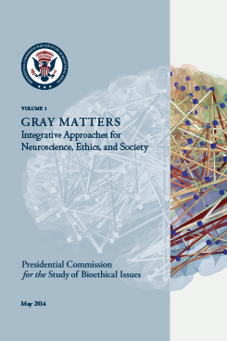
The President asked the Bioethics Commission to "identify proactively a set of core ethical standards – both to guide neuroscience research and to address some of the ethical dilemmas that may be raised by the application of neuroscience research findings." This volume is the first of a two-part response to the President’s request and focuses on the integration of ethics into neuroscience research across the life of a research endeavor.
Integrating ethics explicitly and systematically into the relatively new field of contemporary neuroscience allows us to incorporate ethical insights into the scientific process and to consider societal implications of neuroscience research from the start. Early ethics integration can prevent the need for corrective interventions resulting from ethical mishaps that erode public trust in science. Everyone benefits when the emphasis is on integration, not intervention. Ethics in science must not come to the fore for the first time after something has gone wrong.

Slide 47
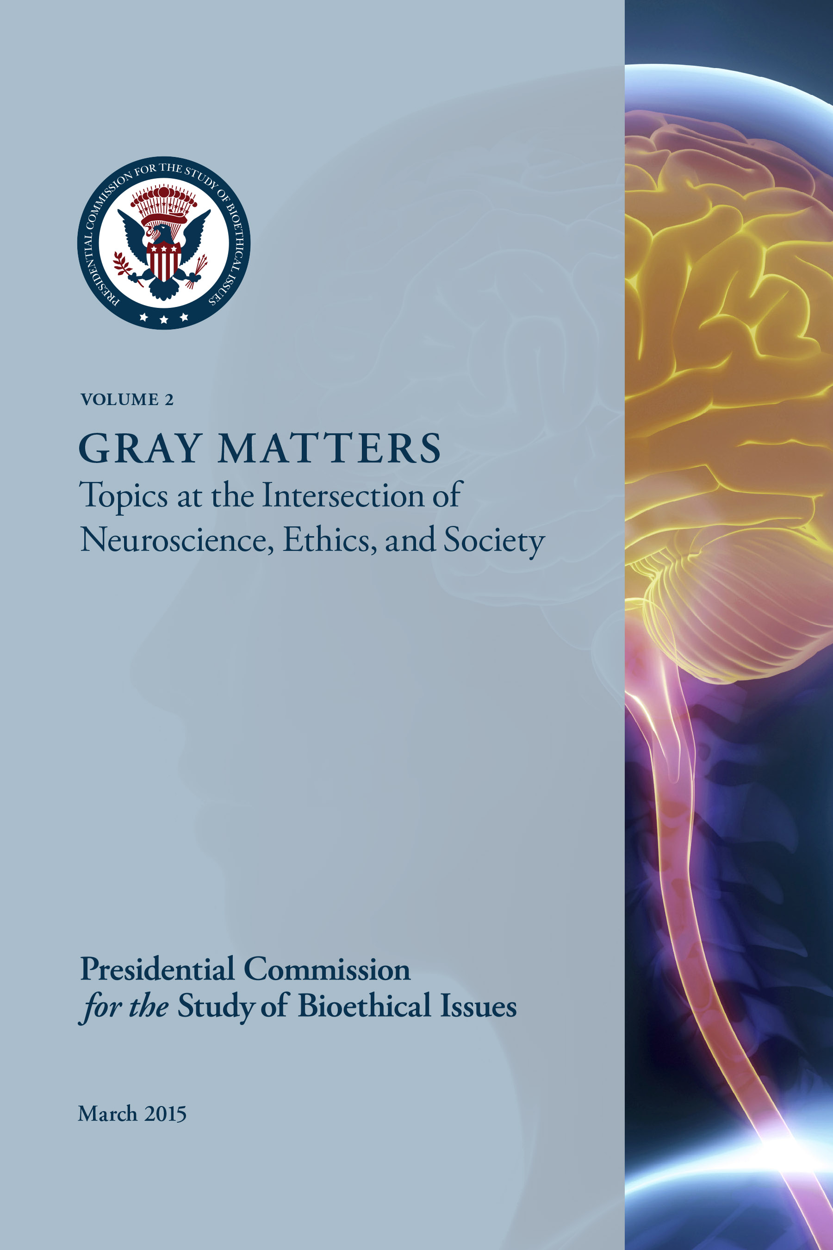
In this report, the Bioethics Commission broadly focused its analysis on three particularly controversial topics that illustrate the ethical tensions and societal implications of advancing neuroscience and technology: cognitive enhancement, consent capacity, and neuroscience and the legal system.
Vol. 2 seeks to clarify the scientific landscape, identify common ground, and recommend ethical paths forward. Cautioning against hyperbole and misinformation when discussing the promise of neuroscience, the report offers 14 recommendations to help clear a path to productive discourse.

Slide 48
National Brain Observatory
White House OSTP BRAIN Initiative FY 2016 Fact Sheet, Feb. 2015 and NSF budget: In FY16, NSF will begin to discuss and coordinate plans for the potential creation of a National Brain Observatory with other agencies and the National Laboratory Network, as specified in the explanatory statement that accompanied the Consolidated and Further Continuing Appropriations Act of 2015 (Public Law 113-225; Dec. 16, 2014).
NSF Workshop on the Feasibility of a National Brain Observatory, 16 Oct. 2015: The long-lasting success of the BRAIN initiative will depend on widespread access to the technological advancements, computational tools, and data-sets created by the initiative. However, there are no existing mechanisms for providing national access to the increasingly technologically and computationally oriented investigations of the brain. The goal of the meeting is to identify key problem areas in neuroscience where technologies found at national labs can be used for the BRAIN initiative and develop a pipeline for future conversations and collaborations between scientists from the National Laboratories and the larger neuroscience community.

Slide 49
National Brain Observatory
Kavli 6 call for “A National Network of Neurotechnology Centers for the BRAIN Initiative”:
A. Paul Alivisatos, Miyoung Chun, George M. Church, Ralph J. Greenspan, Michael L. Roukes, and Rafael Yuste. Neuron, 88, #3, 4 Nov 2015, 445-448.
"We strongly believe that a coordinated national network of neurotechnology centers can play a vital role, both primary and catalytic, in enhancing neuroscience in general, and the progress of the BRAIN Initiative in particular. To support this, we outline four primary areas of the BRAIN Initiative that are crucially dependent on significant technology developments—ones that could profit critically from a center-based framework :”
Connectomics: systematic structural reconstruction of neural circuits
Implantable electrical or photonic neural nanoprobe systems
State-of-the-art optical and magnetic resonance imaging technologies
Advanced storage and computational data mining

Slide 50
Coordinating Global Brain Projects
Sep. 19, 2016
Promoting collaboration and cooperation in the emerging large-scale international brain projects, as part of NSF support for the U.S. BRAIN Initiative.
The National Brain Projects: Current and Future
The United States BRAIN Initiative
The European Union
The Human Brain Project
The Japan Project
Emerging projects in France, Germany, UK, Israel, Korea, China, Canada, and Australia
Non-Government Partner Brain Projects
Allen Institute for Brain Science, Simons Foundation, Howard Hughes Medical Institute, The Kavli Foundation, Lundbeck Foundation, Brain Canada, Brain Behavior Research Foundation, Google, National Photonics Initiative, Inscopix

Slide 51
